Slide 1
#RenewableEnergy
Bhavana Reddy
Charan Musunuru
Karthick Ramasubramanian
Saiteja Reddy Yerasi
Surya Prasad Reddy

Slide 2
Our Data
01
14,000 Tweets
02
Tweepy API to get Tweets (#RenewableEnergy)
03
Final File : Username, Tweet, Followers, Retweets

Slide 3




RoadMap
Sentiment Analysis
Data Pre-processing
Community Detection
Influencer Identification

Slide 4
Community Detection
Community | Frequent words | Topic
Community 1 | Energy, EV, Tesla, Power, Solar, Wind | Energy Solutions
Community 2 | Metamine, Uniswap, Etherium, pancakeswap | Cryptocurrency
Community 3 | Climate crisis, Antarctic, sea level, ice | Global Warming
Community 4 | Africa, access, AFDB, Hydrogen, Powerforall | Development

Slide 5
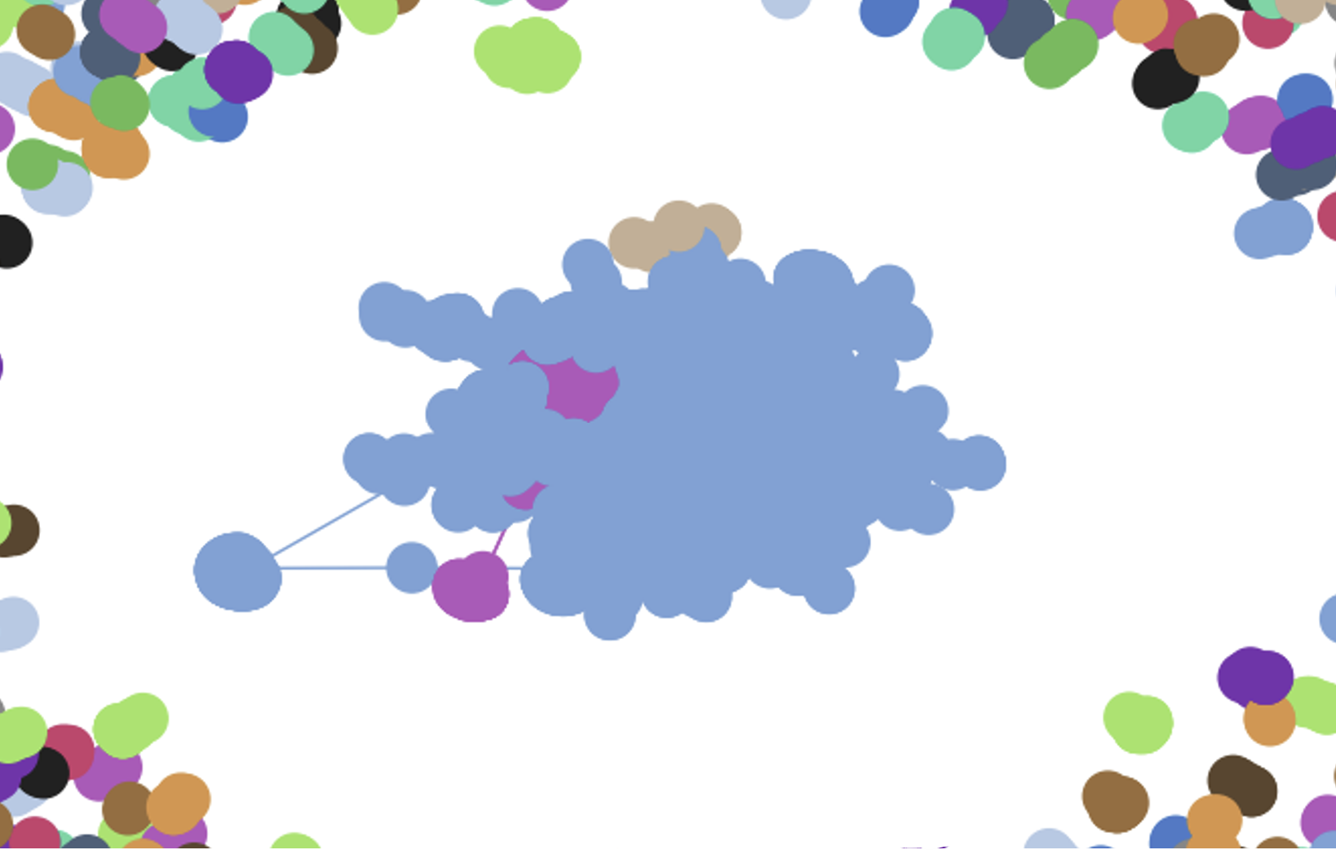
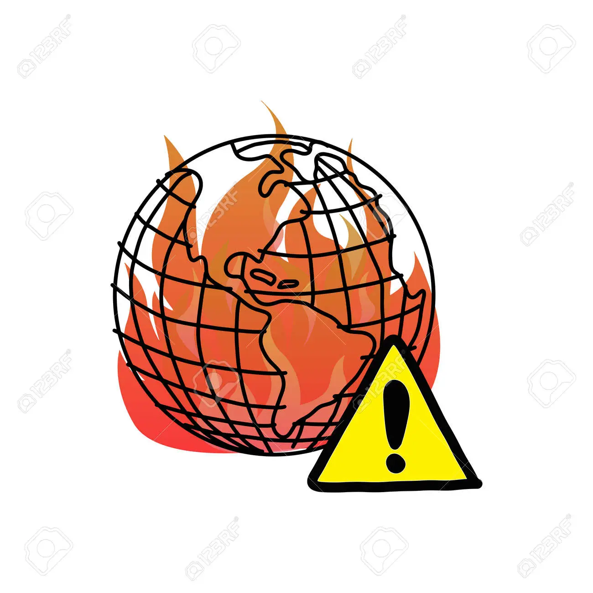




Slide 6
Positive Communities
Community | Frequent words | Topic
Community 1 | Energy, EV, Tesla, Power, Solar, Wind, Amp | Energy Solutions
Community 2 | key, ppa, trade, share, answers | Trade
Community 3 | Africa, access, AFDB, Hydrogen, Powerforall | Development
Community 4 | Policy, time, submit, session, proposal, EUSEW2022, organisation | Policy changes

Slide 7
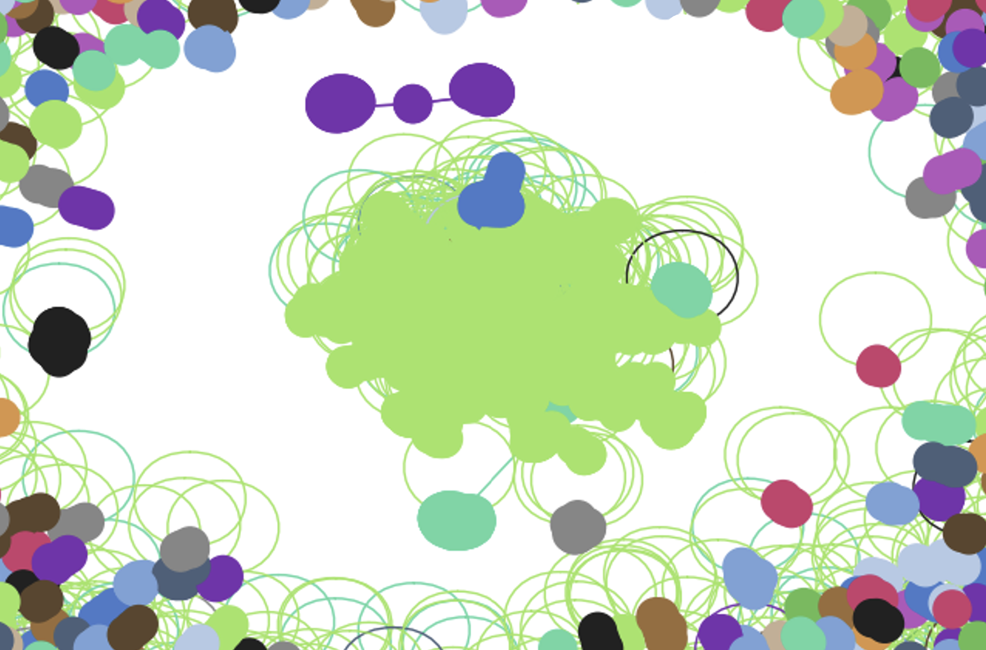
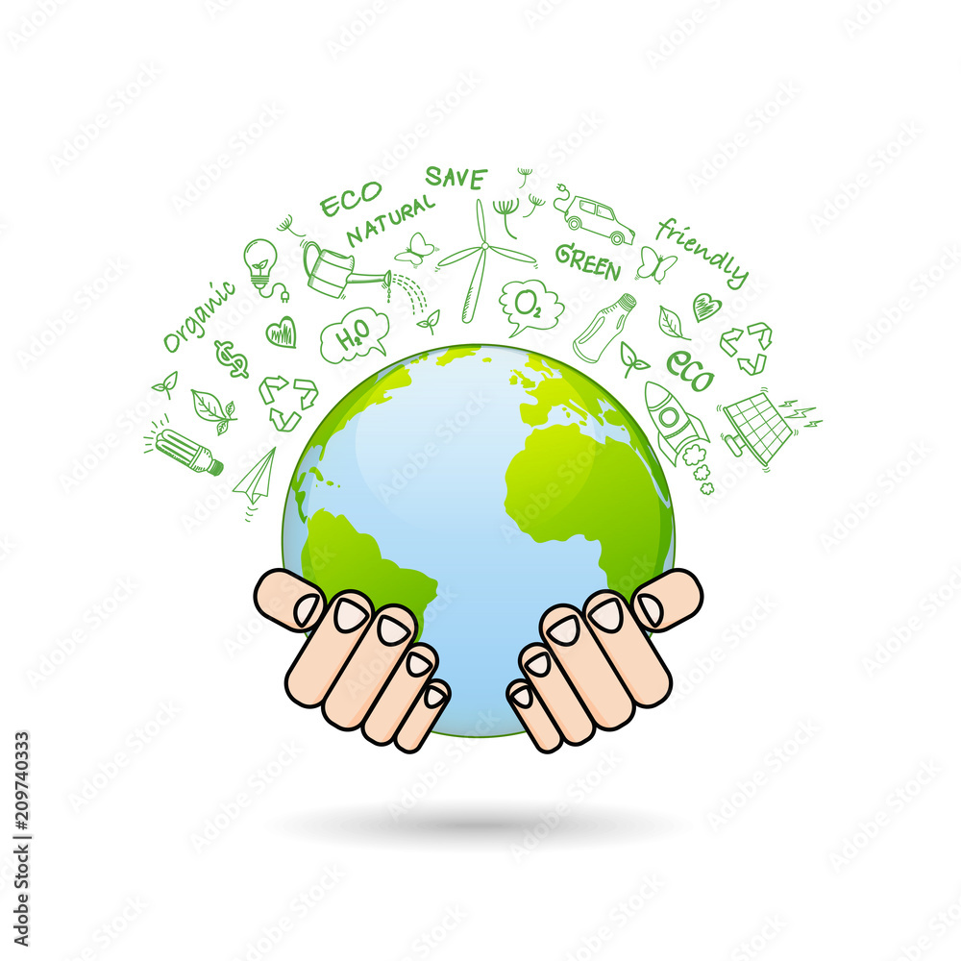
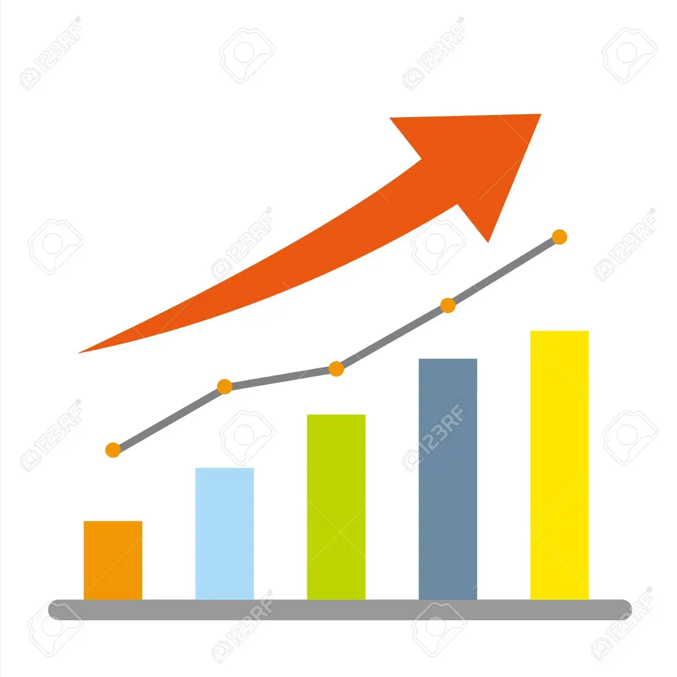

Slide 8
Negative Communities
Community | Frequent words | Topic
Community 1 | Uniswap, pancakeswap, Metamine, Uniswap, Etherium | Cryptocurrency
Community 2 | Climate crisis, Antarctic, sea level, ice, problem, pollute | Global Warming

Slide 9
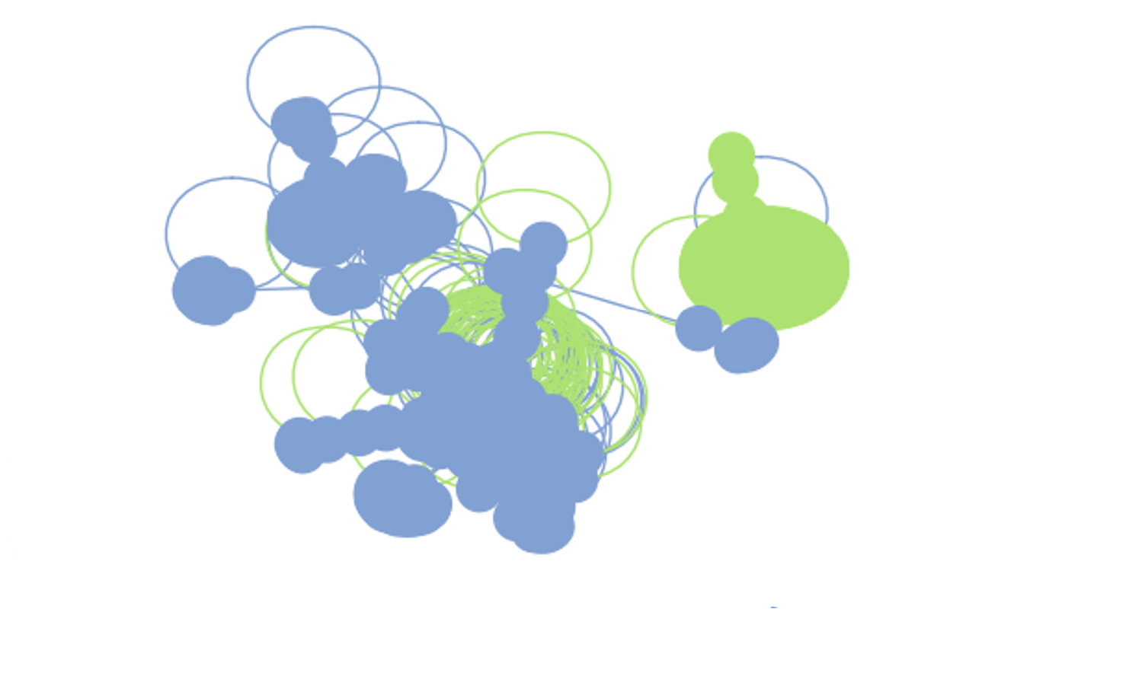

Slide 10

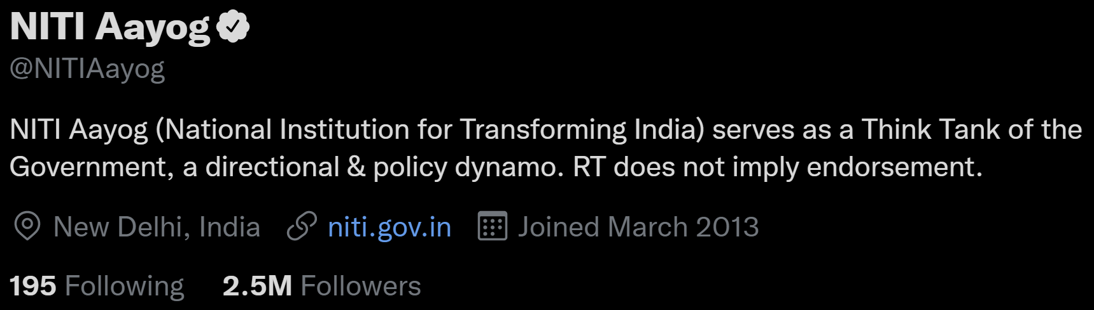
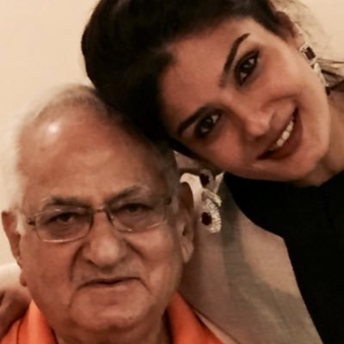
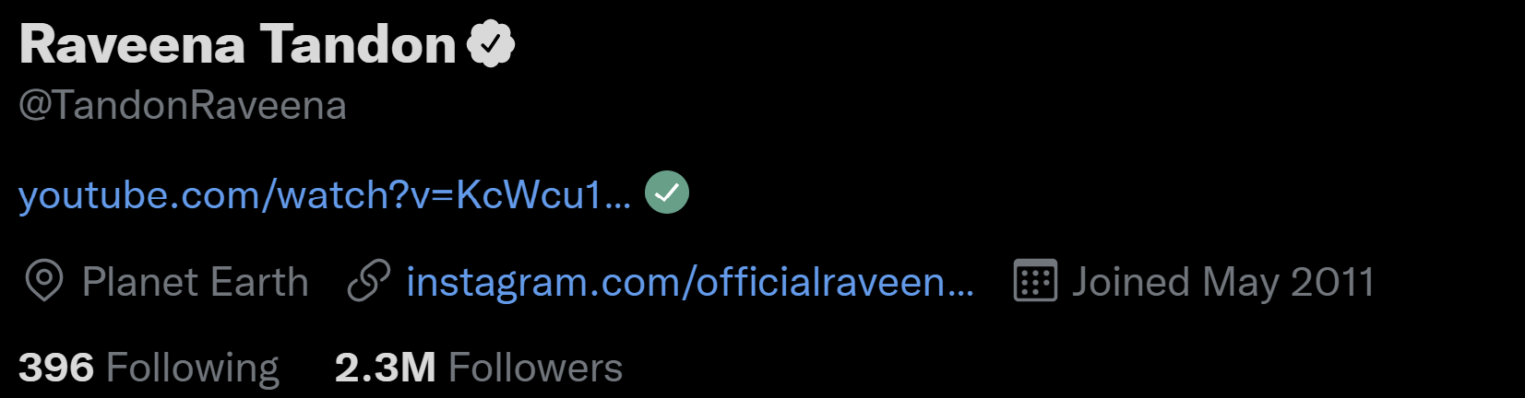
Influencers
Top influencers based on follower count

Slide 11
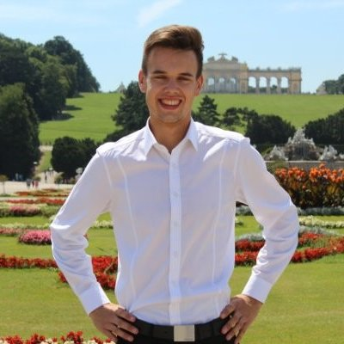
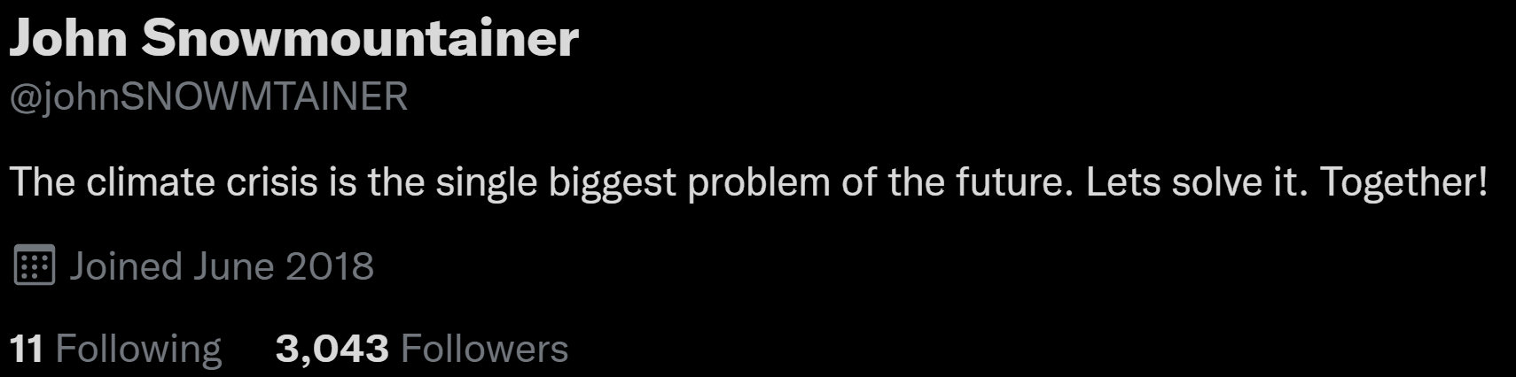
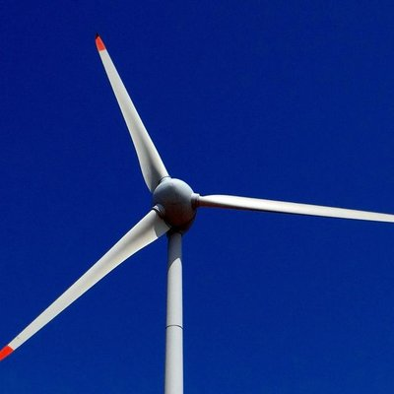
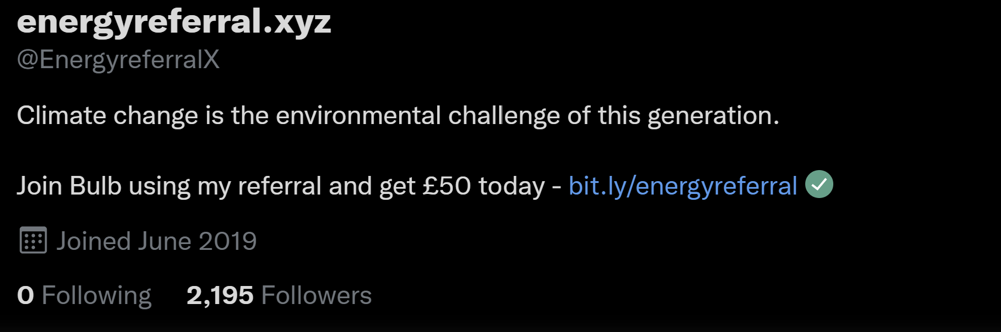
Top influencers based on betweenness centrality

Slide 12
Insights
 | Overall | Positive | Negative
Total users | 6934 | 4530 | 1424
Total tweets | 14000 | 11000 | 3000
No. of users in top communities | 2901(40%) | 1000(22%) | 749(52%)
No of tweets from top communities | 8319(60%) | 5595(51%) | 1705(59%)

Slide 13
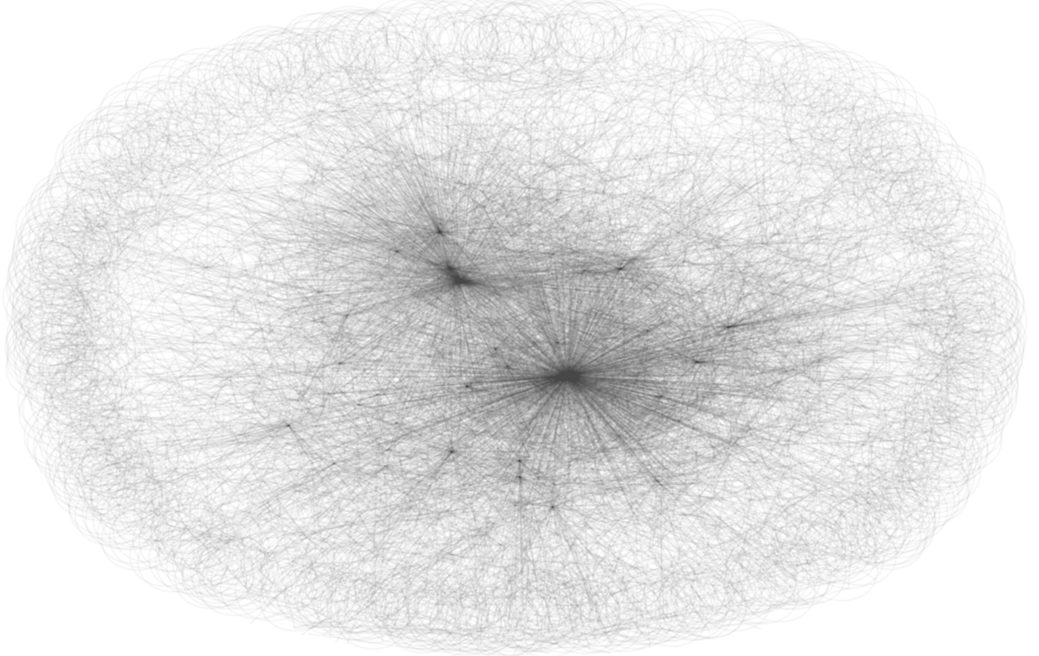
Limited interaction between users

Slide 14
Insights
The users are not well connected
Only certain communities have larger interaction among themselves
Positive sentiment communities focused on action through renewable energy, policy changes, etc. interact much more
Interaction among these communities is less, for better reach these communities should interact with each other

Slide 15
Thank you
02
03
01

